Slide 1
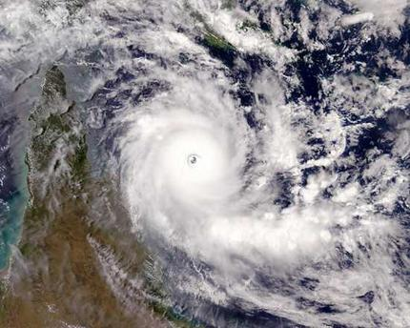
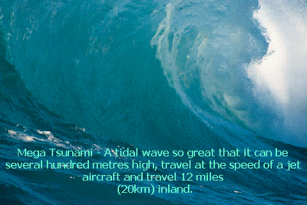
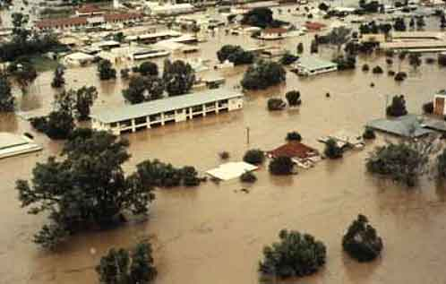
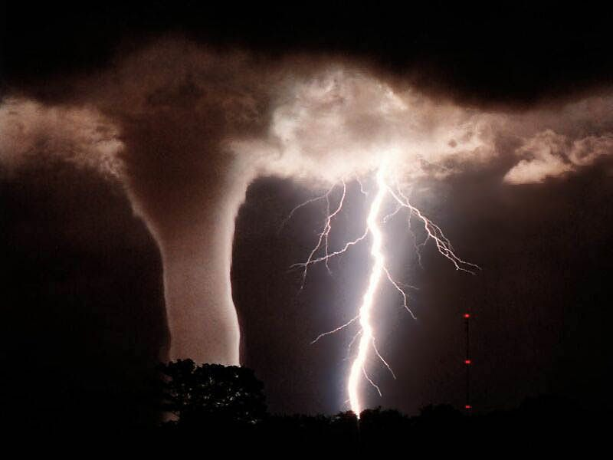
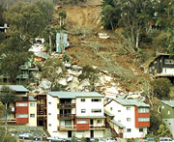
TSUNAMI
CYCLONE
BUSHFIRE
Natural Disasters
1997 Thredbo Landslide
LANDSLIDE
FLOOD
TORNADO

Slide 2
Ordinary Natural Disasters
1. Earthquakes - those in the Ring of Fire
2. Tsunamis - the major one in 2004 killing more than 200, 000 people in South Asian region.
3. Twisters in the USA
4. Bushfires in Australia

Slide 3
Landslides
Avalanches or landslips
Mass of rocks and earth slipping down hill or slope
Different forms:

Slide 4
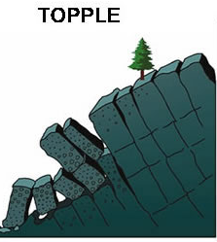
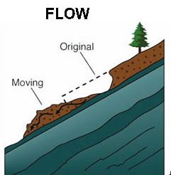
Different Forms of Landslides
1 & 2

Slide 5
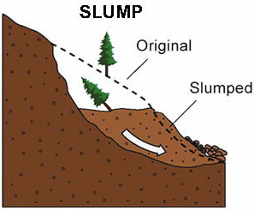
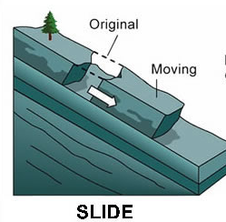
Different Forms of Landslides
3 & 4

Slide 6
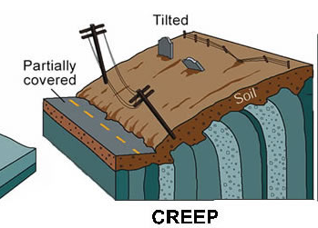
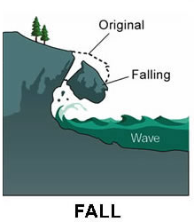
Different Forms of Landslides
5 & 6

Slide 7
Landslides in General
Natural disaster caused by:
1. Intense rainfall or melting snow for long time
2. Long time ground erosion:
Weakened ground structure
3. Sudden ground movement due to earthquakes

Slide 8
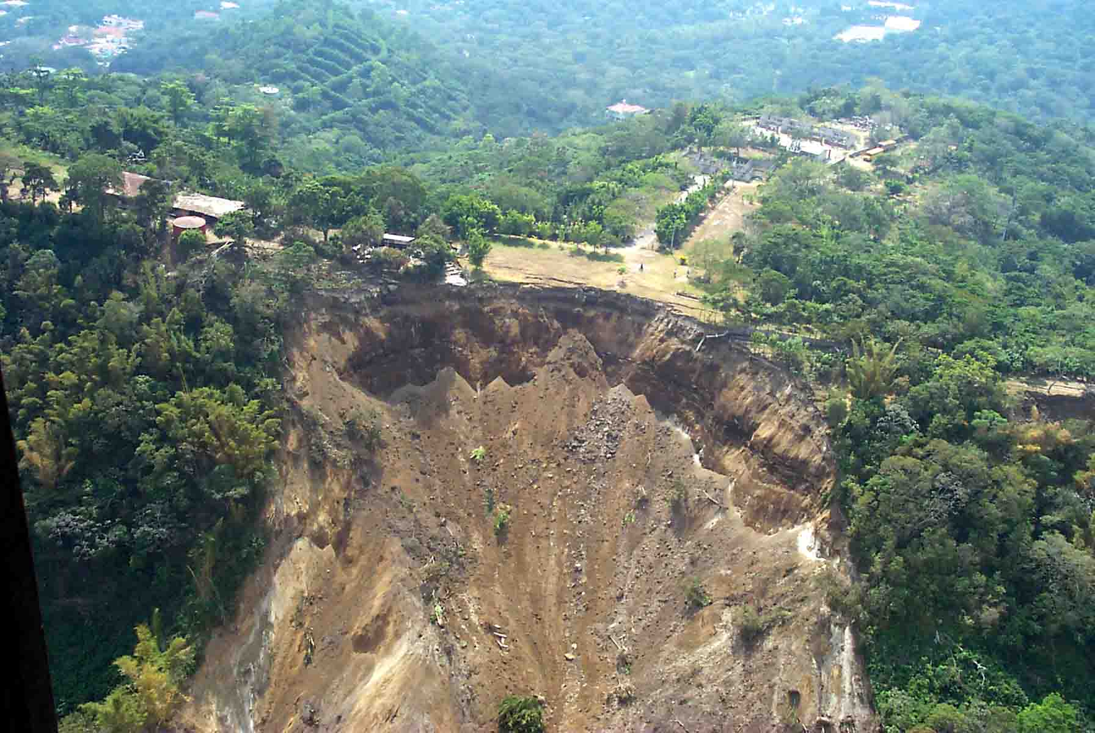
As a Result
Mass of rocks, earth, mud and debris sliding down slope

Slide 9
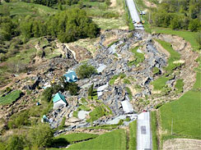
Most Recent Landslides
Landslides everyday and everywhere
Sinkhole : May 11th , 2010, in Montreal, Canada, killing family of 4
SINKHOLE

Slide 10
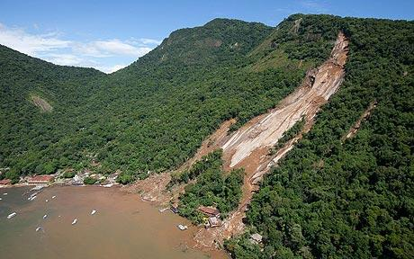
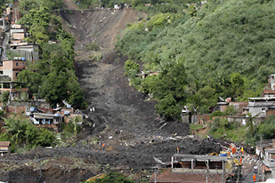
JAN 2010 Brazil Landslide
In Jan 2010, Major mudslide for 3 days
200 people lost life, hundreds homeless and millions of dollars damages

Slide 11
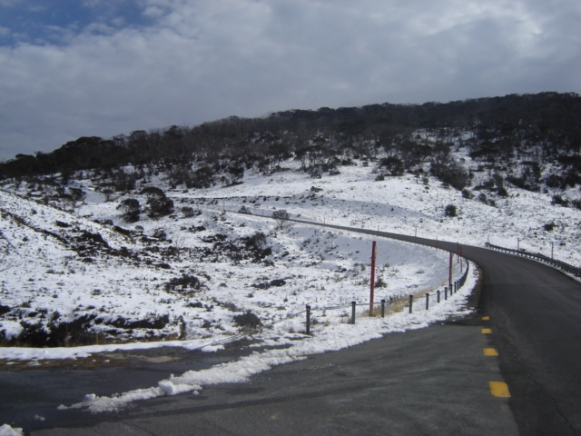
However,
Thredbo Landslide : found more due to human negligence than natural cause
ALPINE WAY

Slide 12
Thredbo Landslide
Thredbo: 200 km from Canberra
In Kosciusko National Park
Part of Snowy Mountain Skiing Precinct
Attract millions of tourists every year
Holiday resort built along Thredbo slope

Slide 13
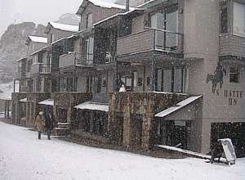
Thredbo Ski Village
Thredbo Ski Lodge

Slide 14
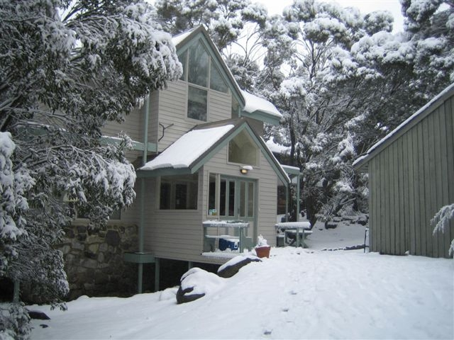
Thredbo Ski Village
Thredbo Ski Lodge

Slide 15
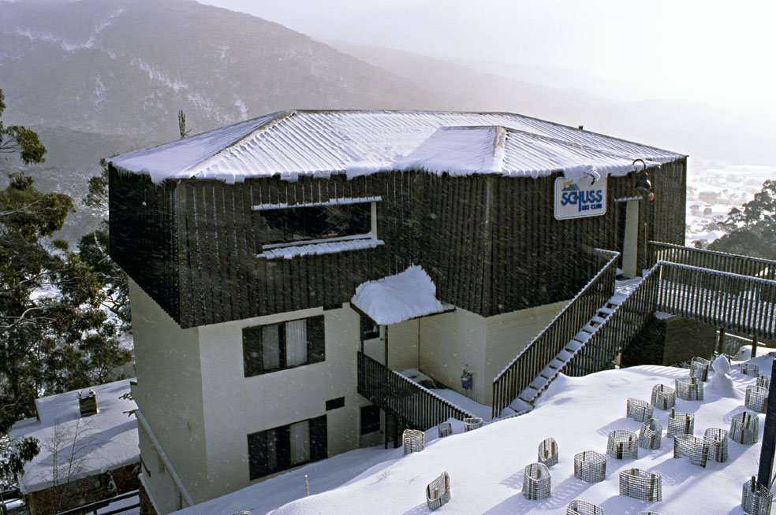
Thredbo Ski Village
Thredbo Ski Lodge

Slide 16
Thredbo Landslide
Date & Time:
Wednesday
July 30th 1997
11:37 pm

Slide 17
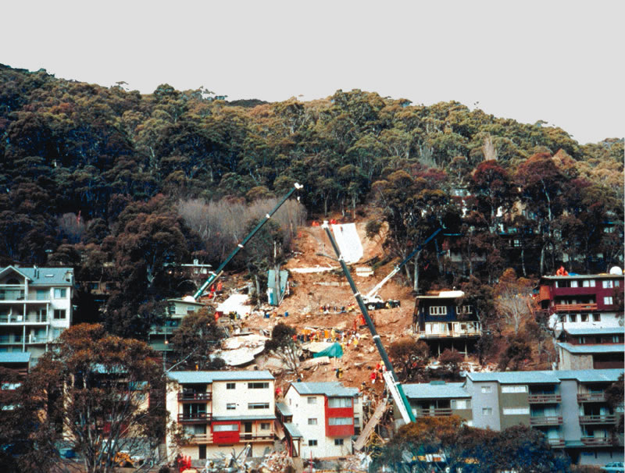
Landslide Scale and Effects
3500 tonnes of debris and rubble crashing down slope

Slide 18
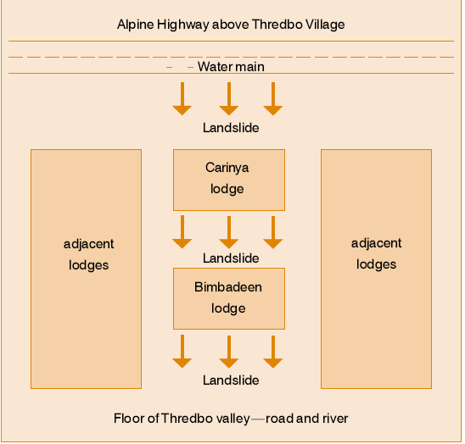
Landslide Scale and Effects
Completely destroyed two main ski lodges ( Carinya and Bimbadeen )

Slide 19
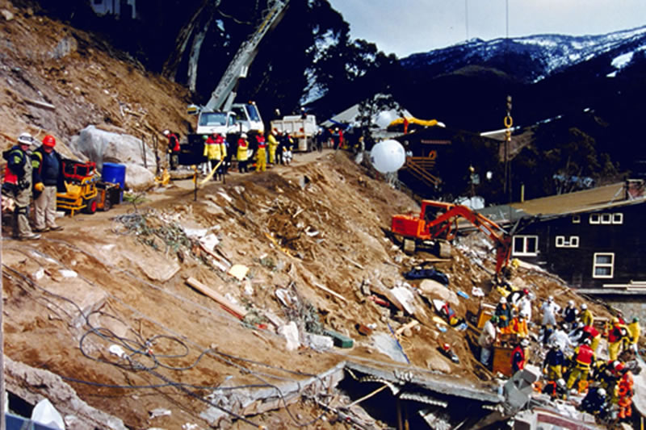
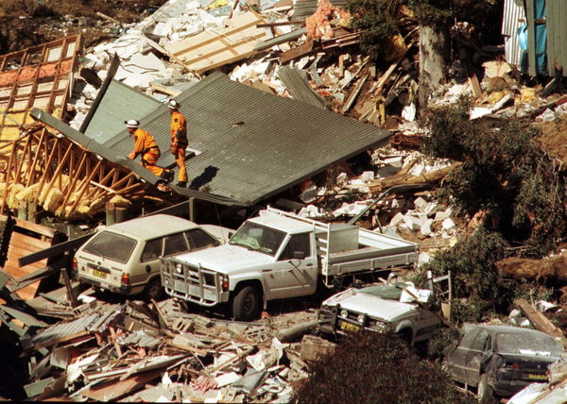
Landslide Scale and Effects

Slide 20
Landslide Scale and Effects
Killing 18 people without any slight warning

Slide 21
Landslide Scale and Effects
Skiing business lost $30 million
As people still in landslide nightmare

Slide 22
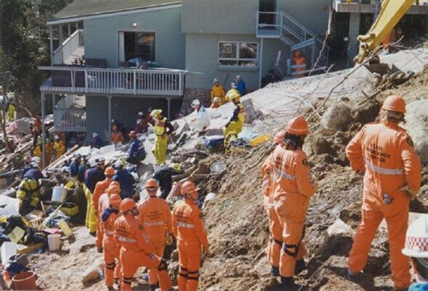
Landslide Scale and Effects
NSW Government compensated $40 million for affected.

Slide 23
Landslide Scale and Effects
Since then, NSW government spent $50 million repairing and upgrading Thredbo area.

Slide 24
Cause of the Thredbo Landslide
1. The faulty Alpine Way:
Alpine Way : Main road to ski fields
Was first built for temporary purpose
Was intended to be used no more than 20 years
But used for 50 years at time of incident
Overlooking duty failed.

Slide 25
Cause of the Thredbo Landslide
2. Human negligence of maintenance and constant assessment of Alpine Way:
No one understood why Alpine Way existed for so long
No one ever challenged safety issue of Alpine Way
NSW State Government was blamed for breach of duty of care
Approval of water pipeline was hidden time-bomb

Slide 26
Cause of the Thredbo Landslide
3. The malfunctioning of the pipeline:
Built on already unsafe site
Joint of pipe was again another fault
Continuous water leakage caused soil movement

Slide 27
Cause of the Thredbo Landslide
4. Increasing commercial activities:
More tourists, more using of Alpine Way and Thredbo slope
Faster rate Alpine Way deteriorate
Blooming business at expense of Thredbo Village structure

Slide 28
The Ultimate Effect
Thredbo Landslide
3500 tonnes of rocks and debris came crashing downhill

Slide 29
Lessons Learnt From the Thredbo Landslide
1. “Precaution is always better than cure”:
Co-ordination in Government: ensure safety of public facilities
More accountability in government
Complacency of bureaucrats is No-no
Government is to serve and protect its citizens

Slide 30
Lessons Learnt From the Thredbo Landslide
2.Be prepared for the worst:
Stuart Diver
Only survivor endured 65 hours
Excellent survival skill in extreme situation
Still keeping hope of life amidst difficulty
Amazed for his mental, physical and emotional power

Slide 31
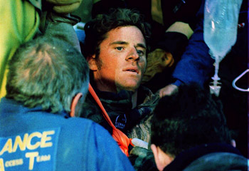
Stuart Diver
Stuart Diver – Ski Instructor
PowerPoint created by:
GLORIA CHOI

